Slide 1


Project Title : Sentiment Analysis
Under Guidance Of
A.Nageswara Rao

Slide 2

Sentiment Analysis
Batch 16
Machine Learning

Slide 3



Problem Definition
Given a comment, classify whether the comment is of positive, negative. For comment conveying both a positive and negative sentiment, whichever is the stronger sentiment should be chosen.

Slide 4
Sentiment analysis, otherwise known as opinion mining, works thanks to natural language processing (NLP) and machine learning algorithms, to automatically determine the emotional tone behind online conversations. The type of bucket used in the project is Automatic: systems rely on machine learning techniques to learn from data.
What is Sentiment Analysis ?

Slide 5
How Sentiment Analysis Work?
There is lot of unstructured data (emails, support tickets, chats, social media conversations, surveys, articles, documents). Sentiment analysis can help in making sense of this data. People post things on twitter and instagram. The tweets can be collected that have the product hash tag with them. Then sentiment analysis model can be used to classify the tweets.

Slide 6
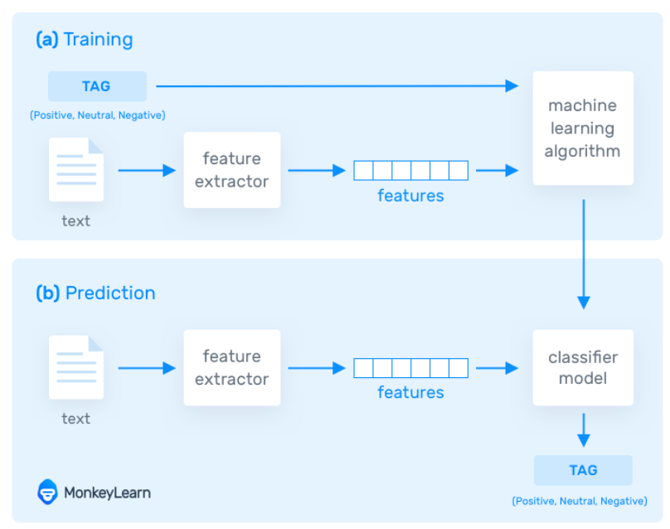



PROCESS

Slide 7

Methodology
Logistic Regression
Logistic regression is a supervised learning classification algorithm used to predict the probability of a target variable.
The nature of target or dependent variable is dichotomous, which means there would be only two possible classes.
In simple words, the dependent variable is binary in nature having data coded as either 1 (stands for success/yes) or 0 (stands for failure/no).

Slide 8

Advantages Of Sentiment Analysis
Twitter sentiment analysis provides many exciting opportunities. Being able to analyze tweets in real-time, and determine the sentiment that underlies each message, adds a new dimension to social media monitoring.
Social Media Monitoring
Online reputation is one of the most precious assets for brands. A bad review on social media can be costly to a company if it’s not handled effectively and swiftly.
Twitter sentiment analysis allows you to keep track of what’s being said about your product or service on social media, and can help you detect angry customers or negative mentions before they turn into a major crisis.

Slide 9

Conclusion
We Conclude that using different algorithms we can get the different results of the project.Logistic Regression Algorithm is used to classify the tweets and the more we improve the training data set the more accurate results can be acquired.

Slide 10

Presentation By
175A9 - S.Neelima
175E3 - M.Karthik
175F4 - P.Bhargav
175M8 - Md.Ijaz Ahmed

